Slide 1
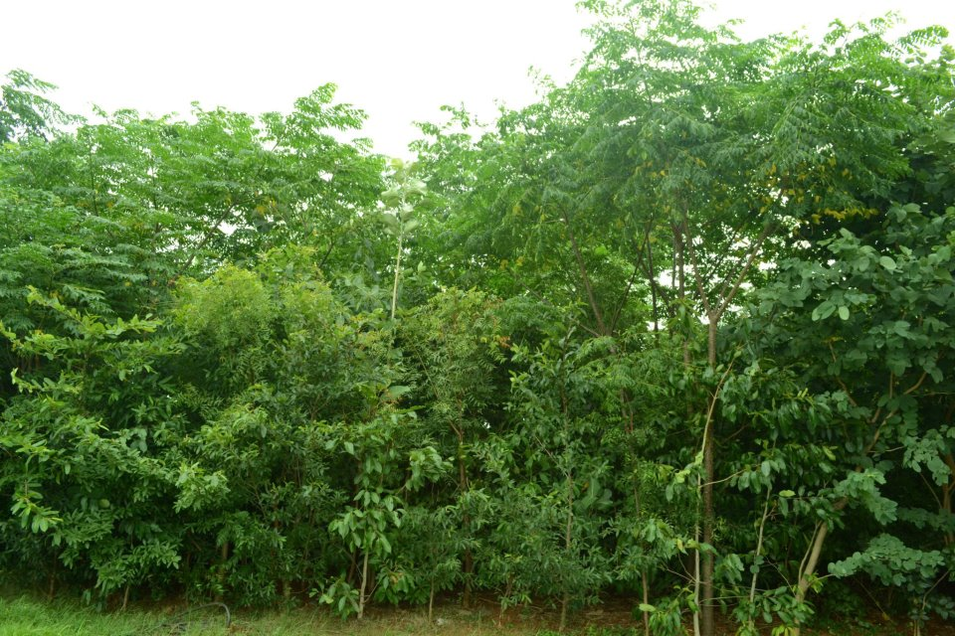

Lets Dare to Dream…

Slide 2
Pilot Project at Clifton
400 Sq mt
1260 plants
40 Native Species

Slide 3
Pilot Project at Clifton
Sehtooot Jamun Neem Badam Kachnaar
Injeer Terminilia Kali Sheesham
Sumbul Ber Mango Bor
Fishtail Palm Alestonia Arjun Guava
Anar Lemon Kaneer Wood Apple
Curry Leaf Kathal Seedha Ashok Peepal
Sohanjna Taboobia Gule Nishtar Amaltas Babool
White Siris Shirin kackronda
Gulabi Cassia Sheesham Sukh Chain
Champa Bidi Patta Amla

Slide 4
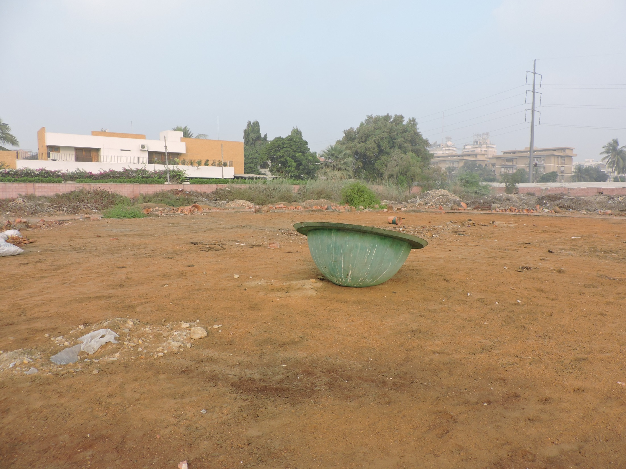

Slide 5
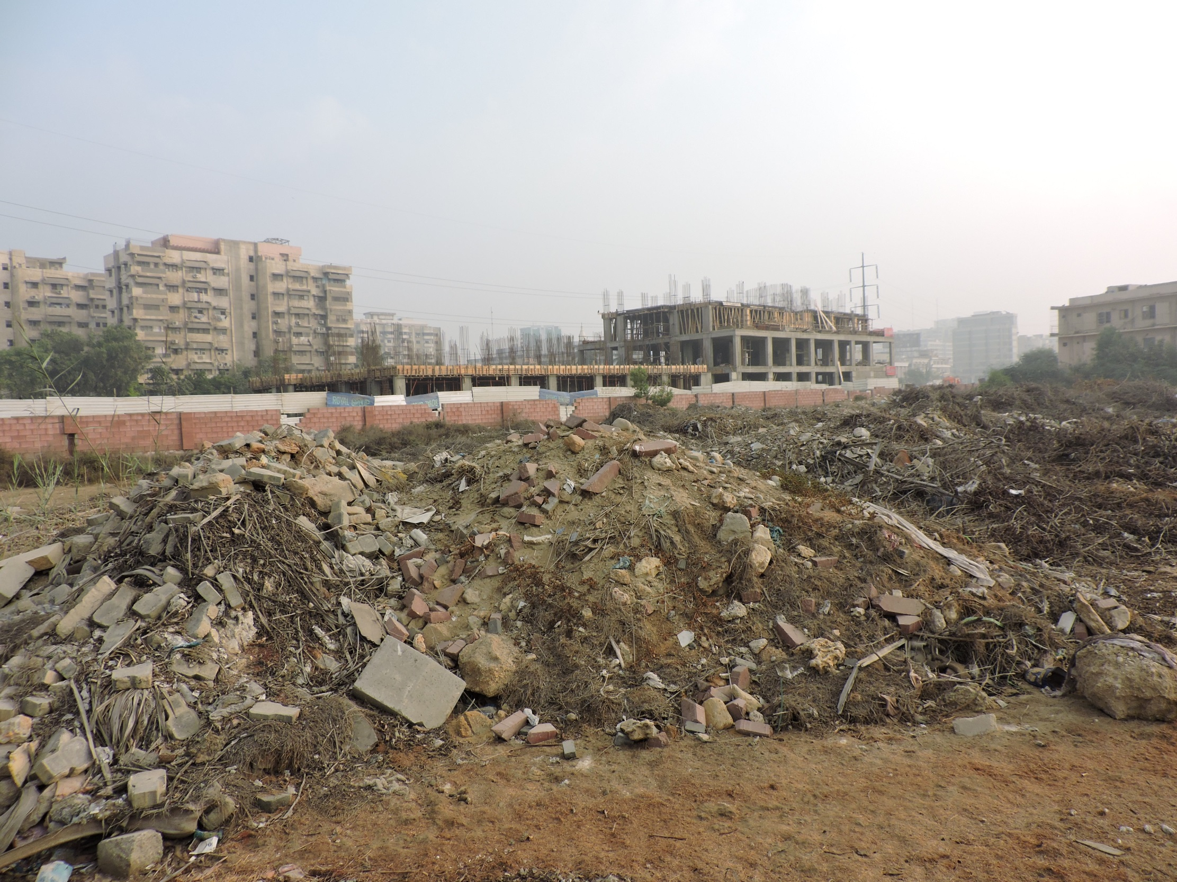

Slide 6
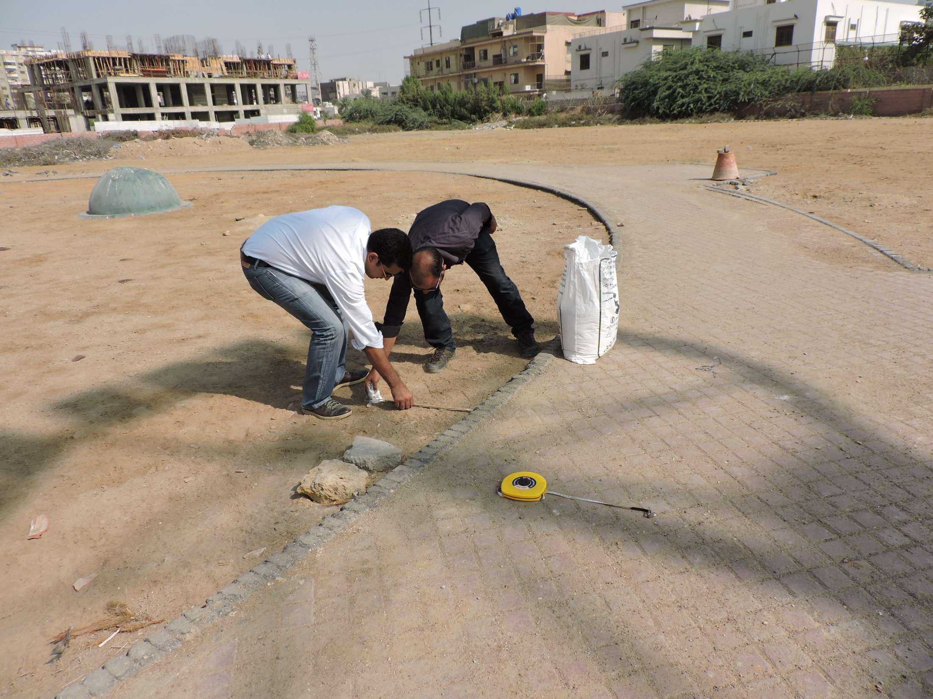

Slide 7
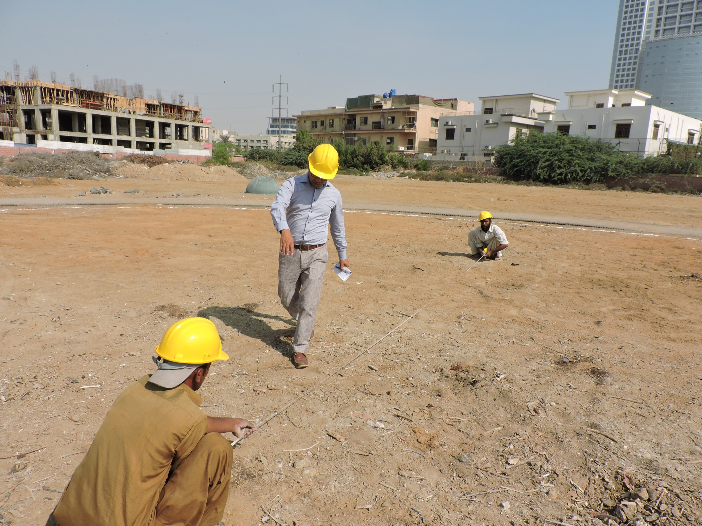

Slide 8
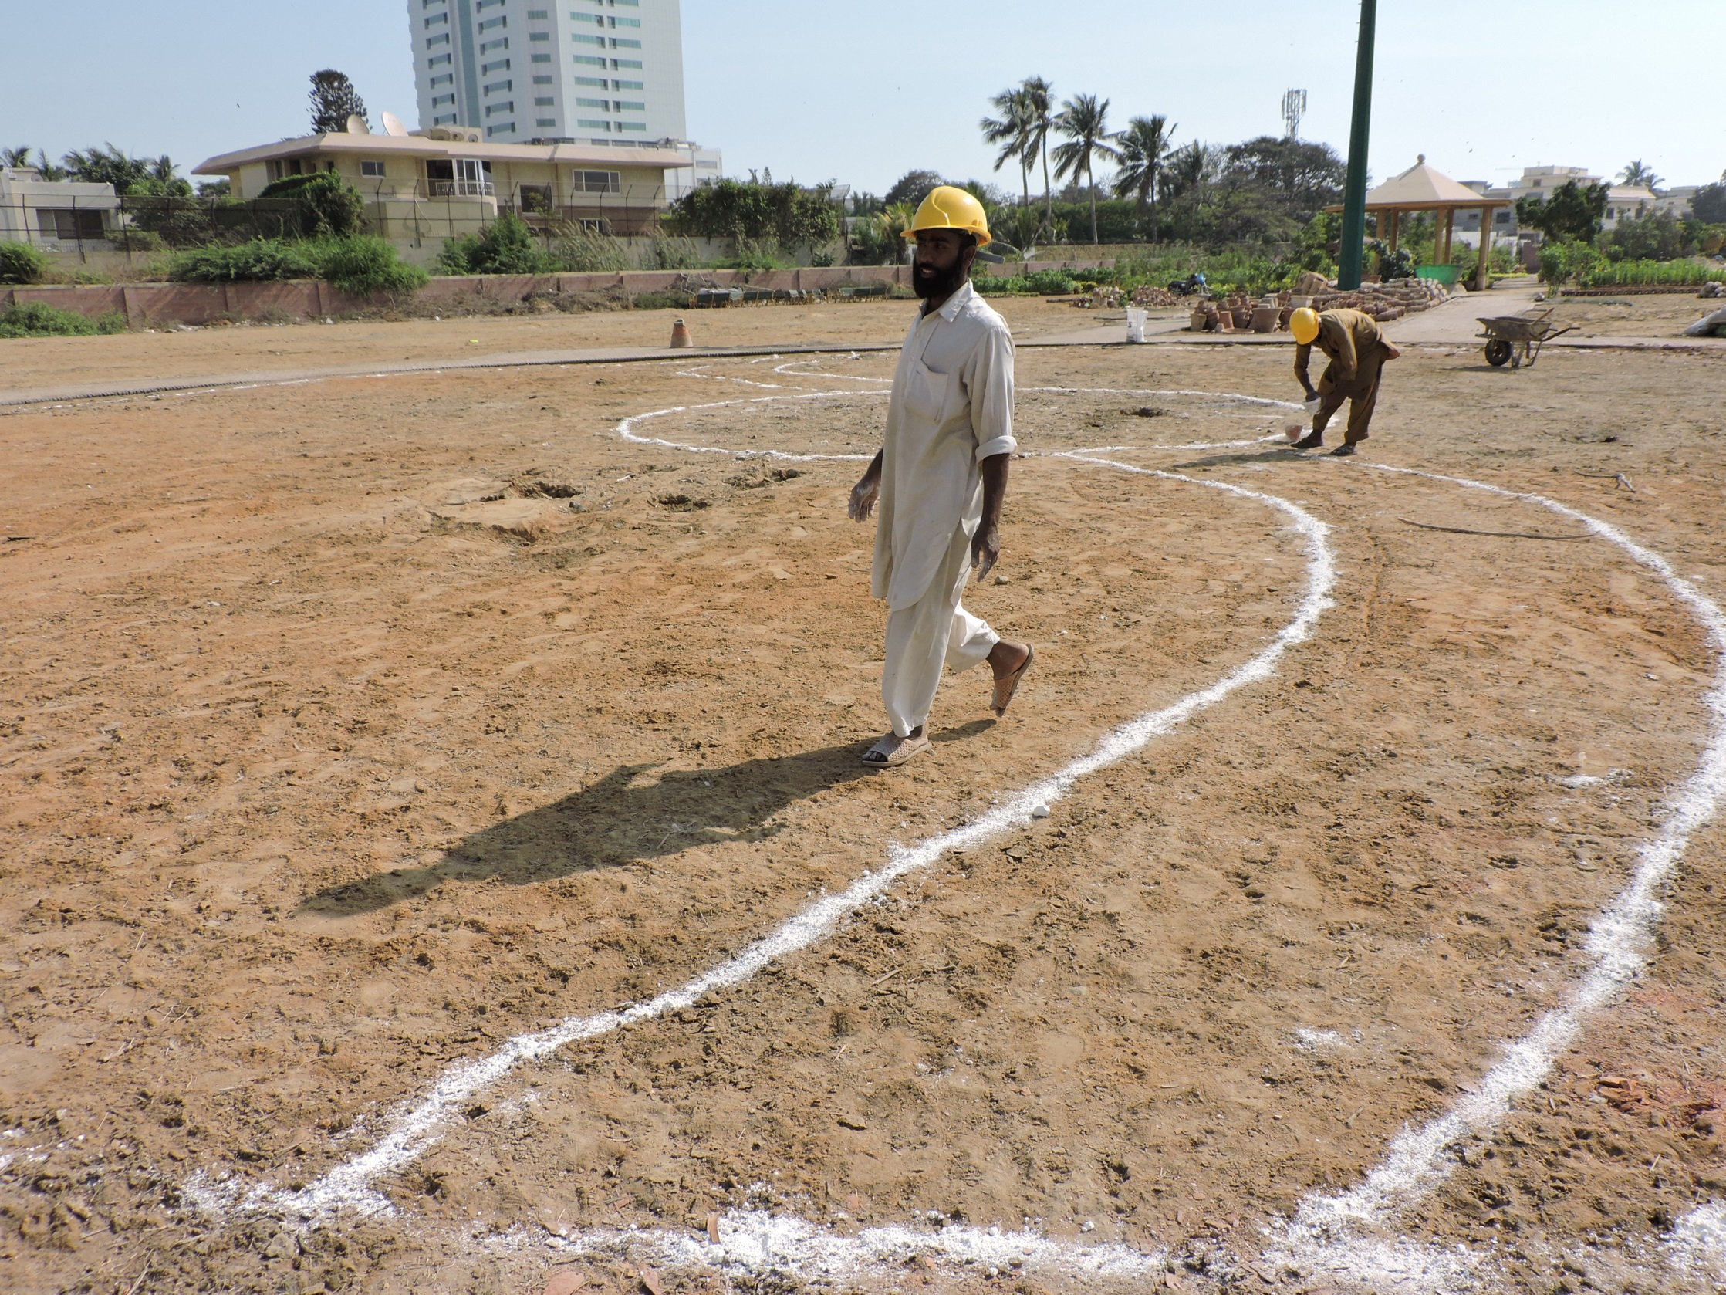

Slide 9
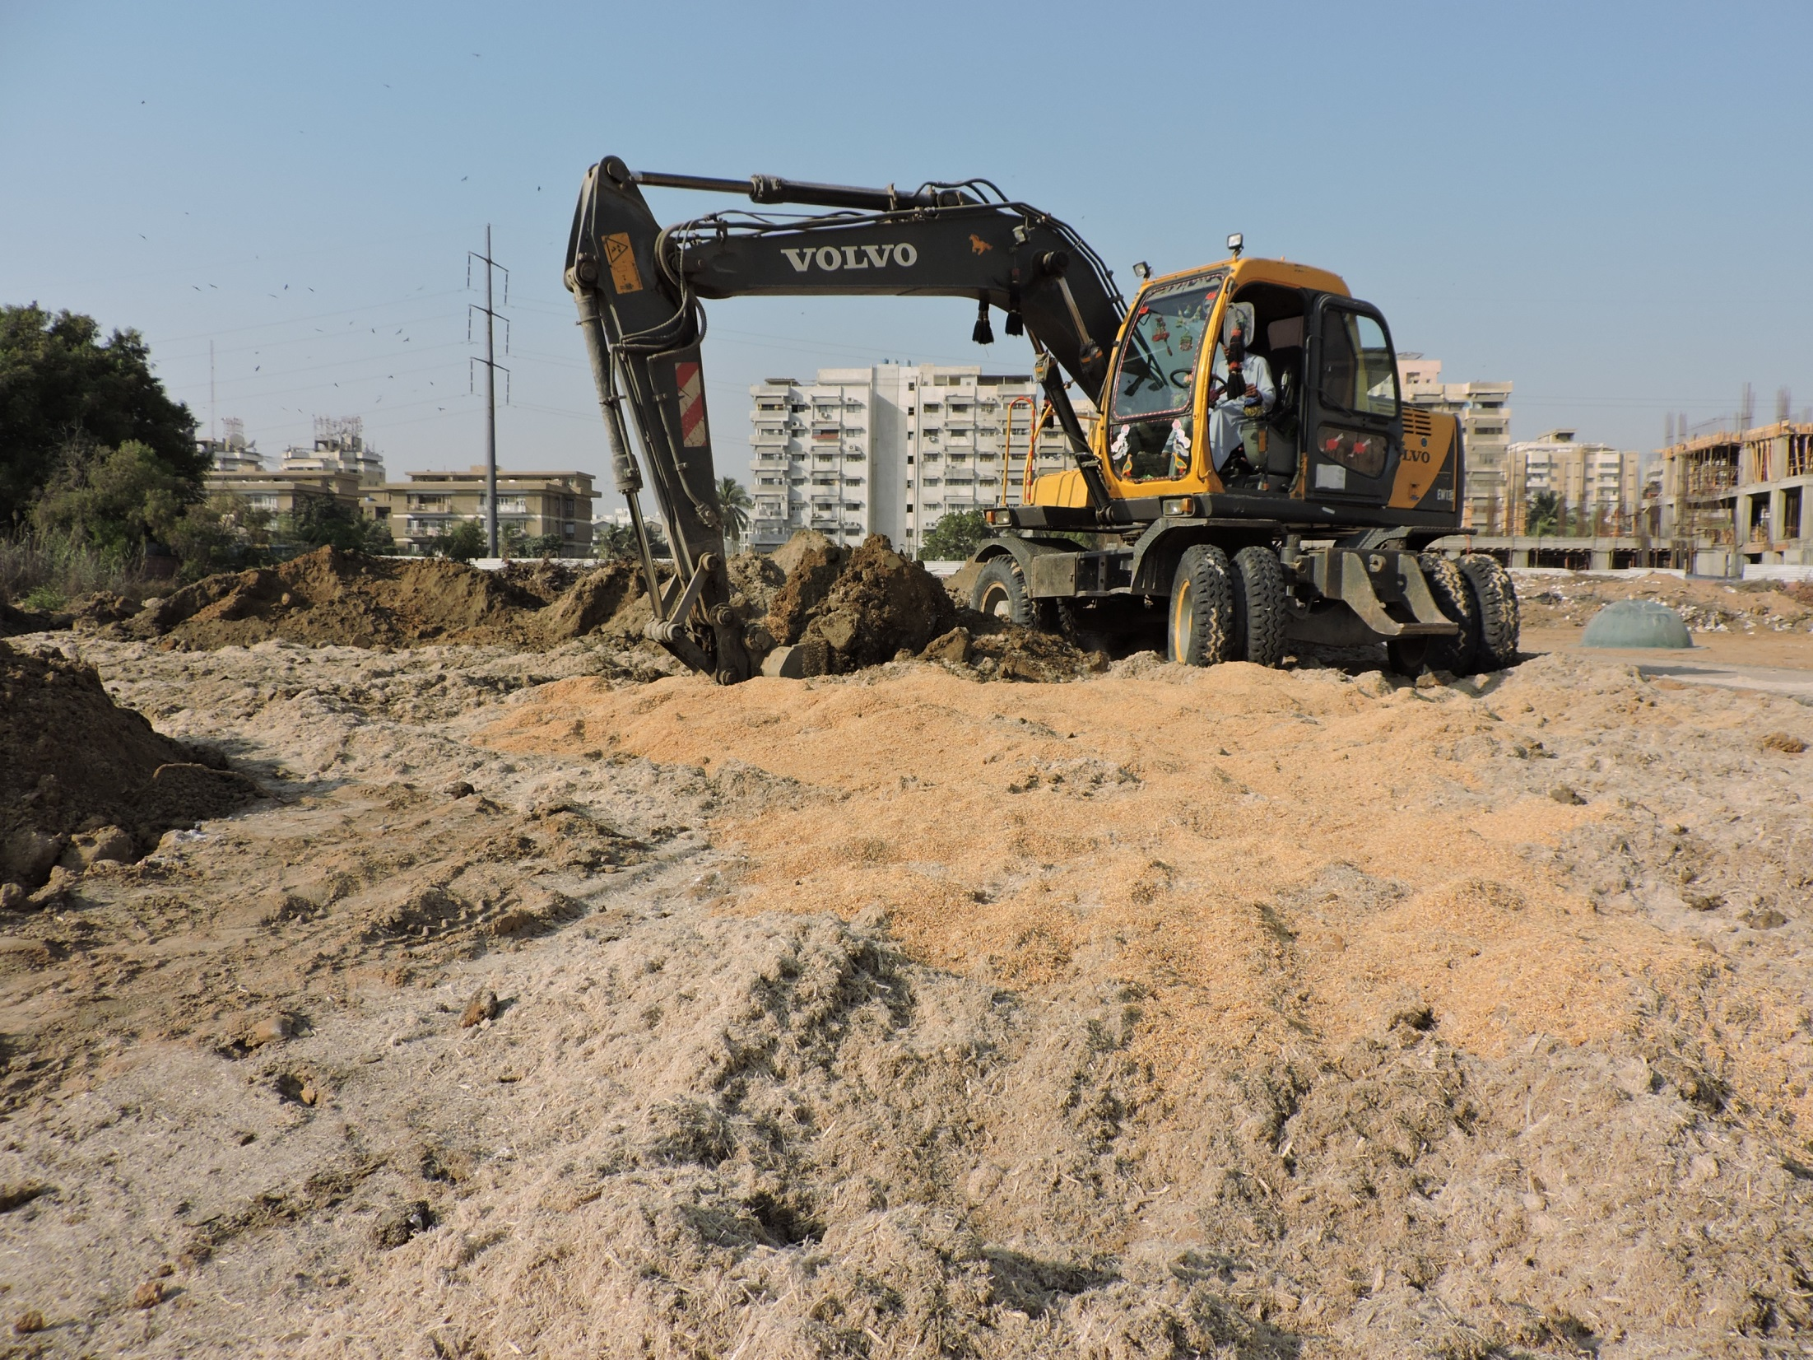

Slide 10
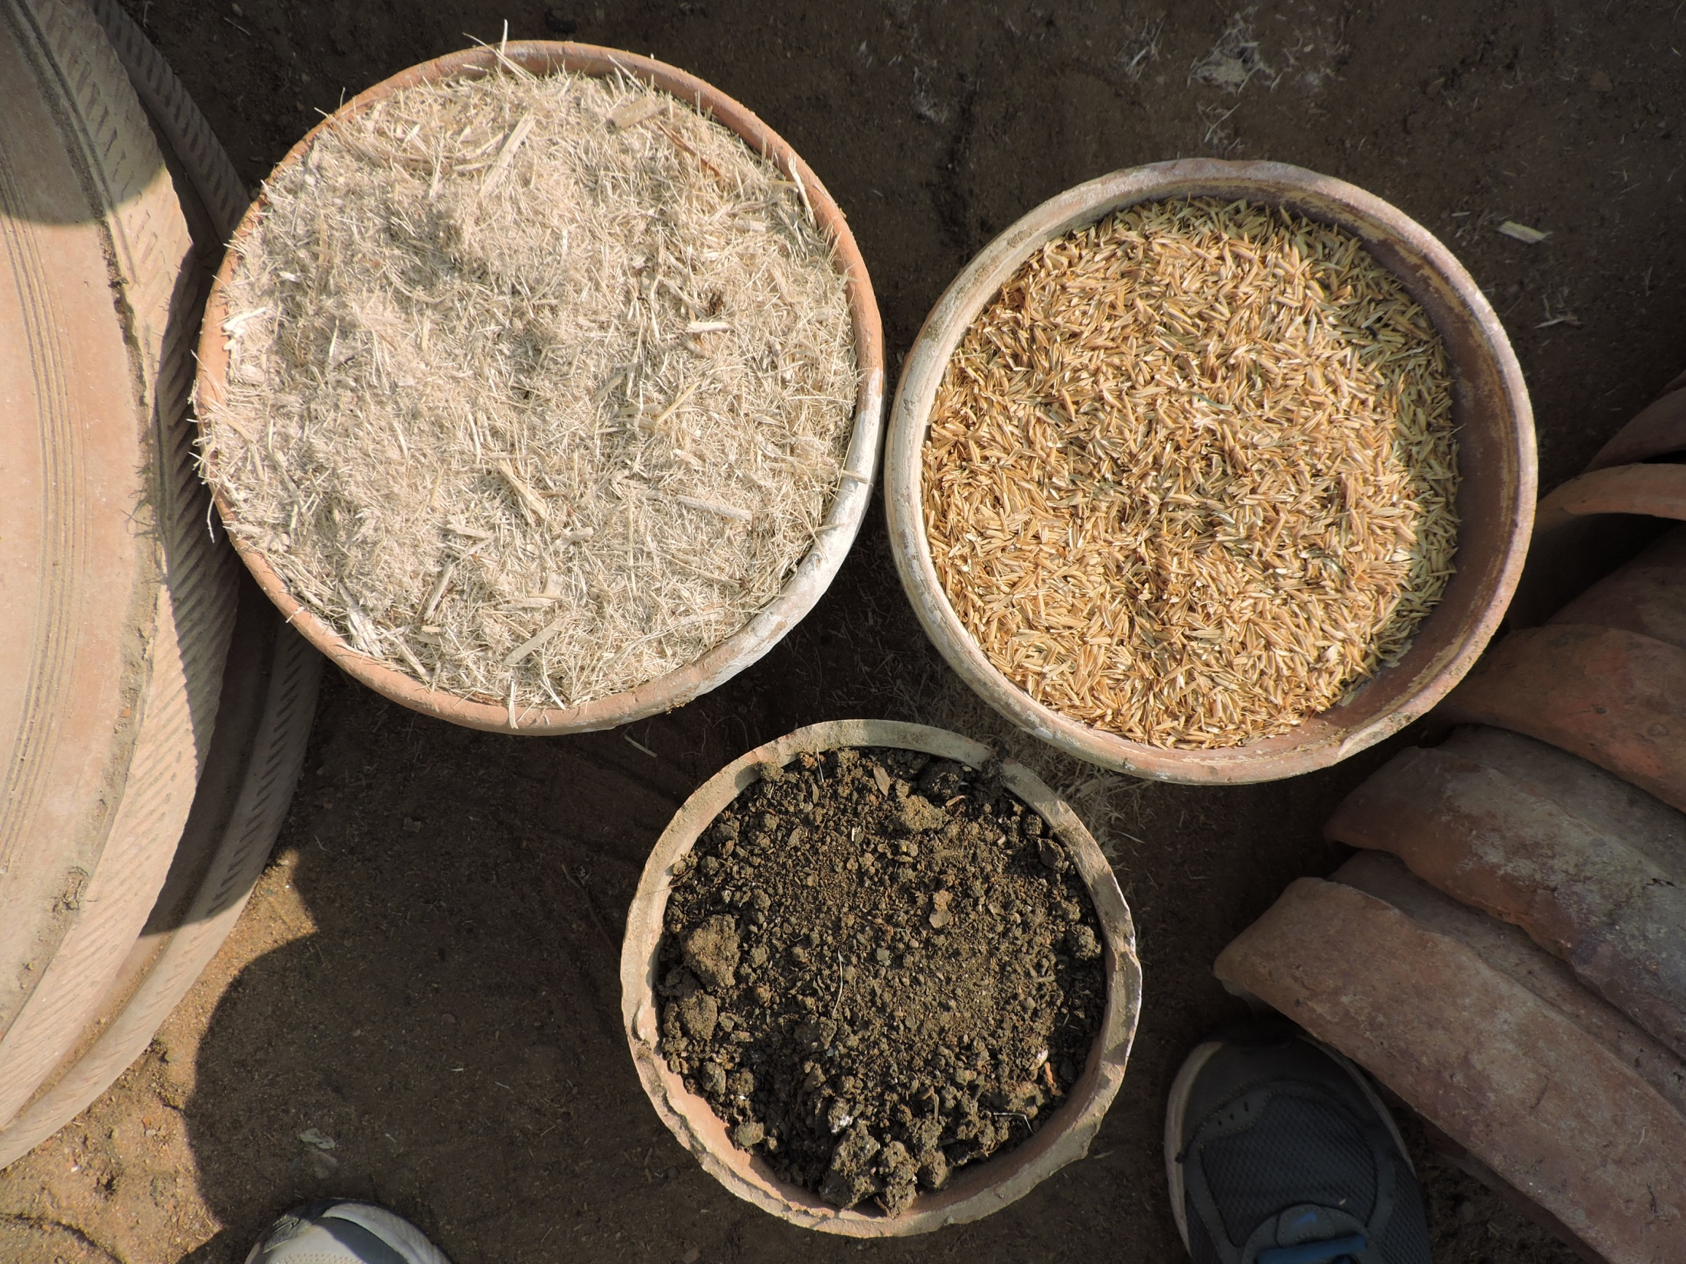

Slide 11
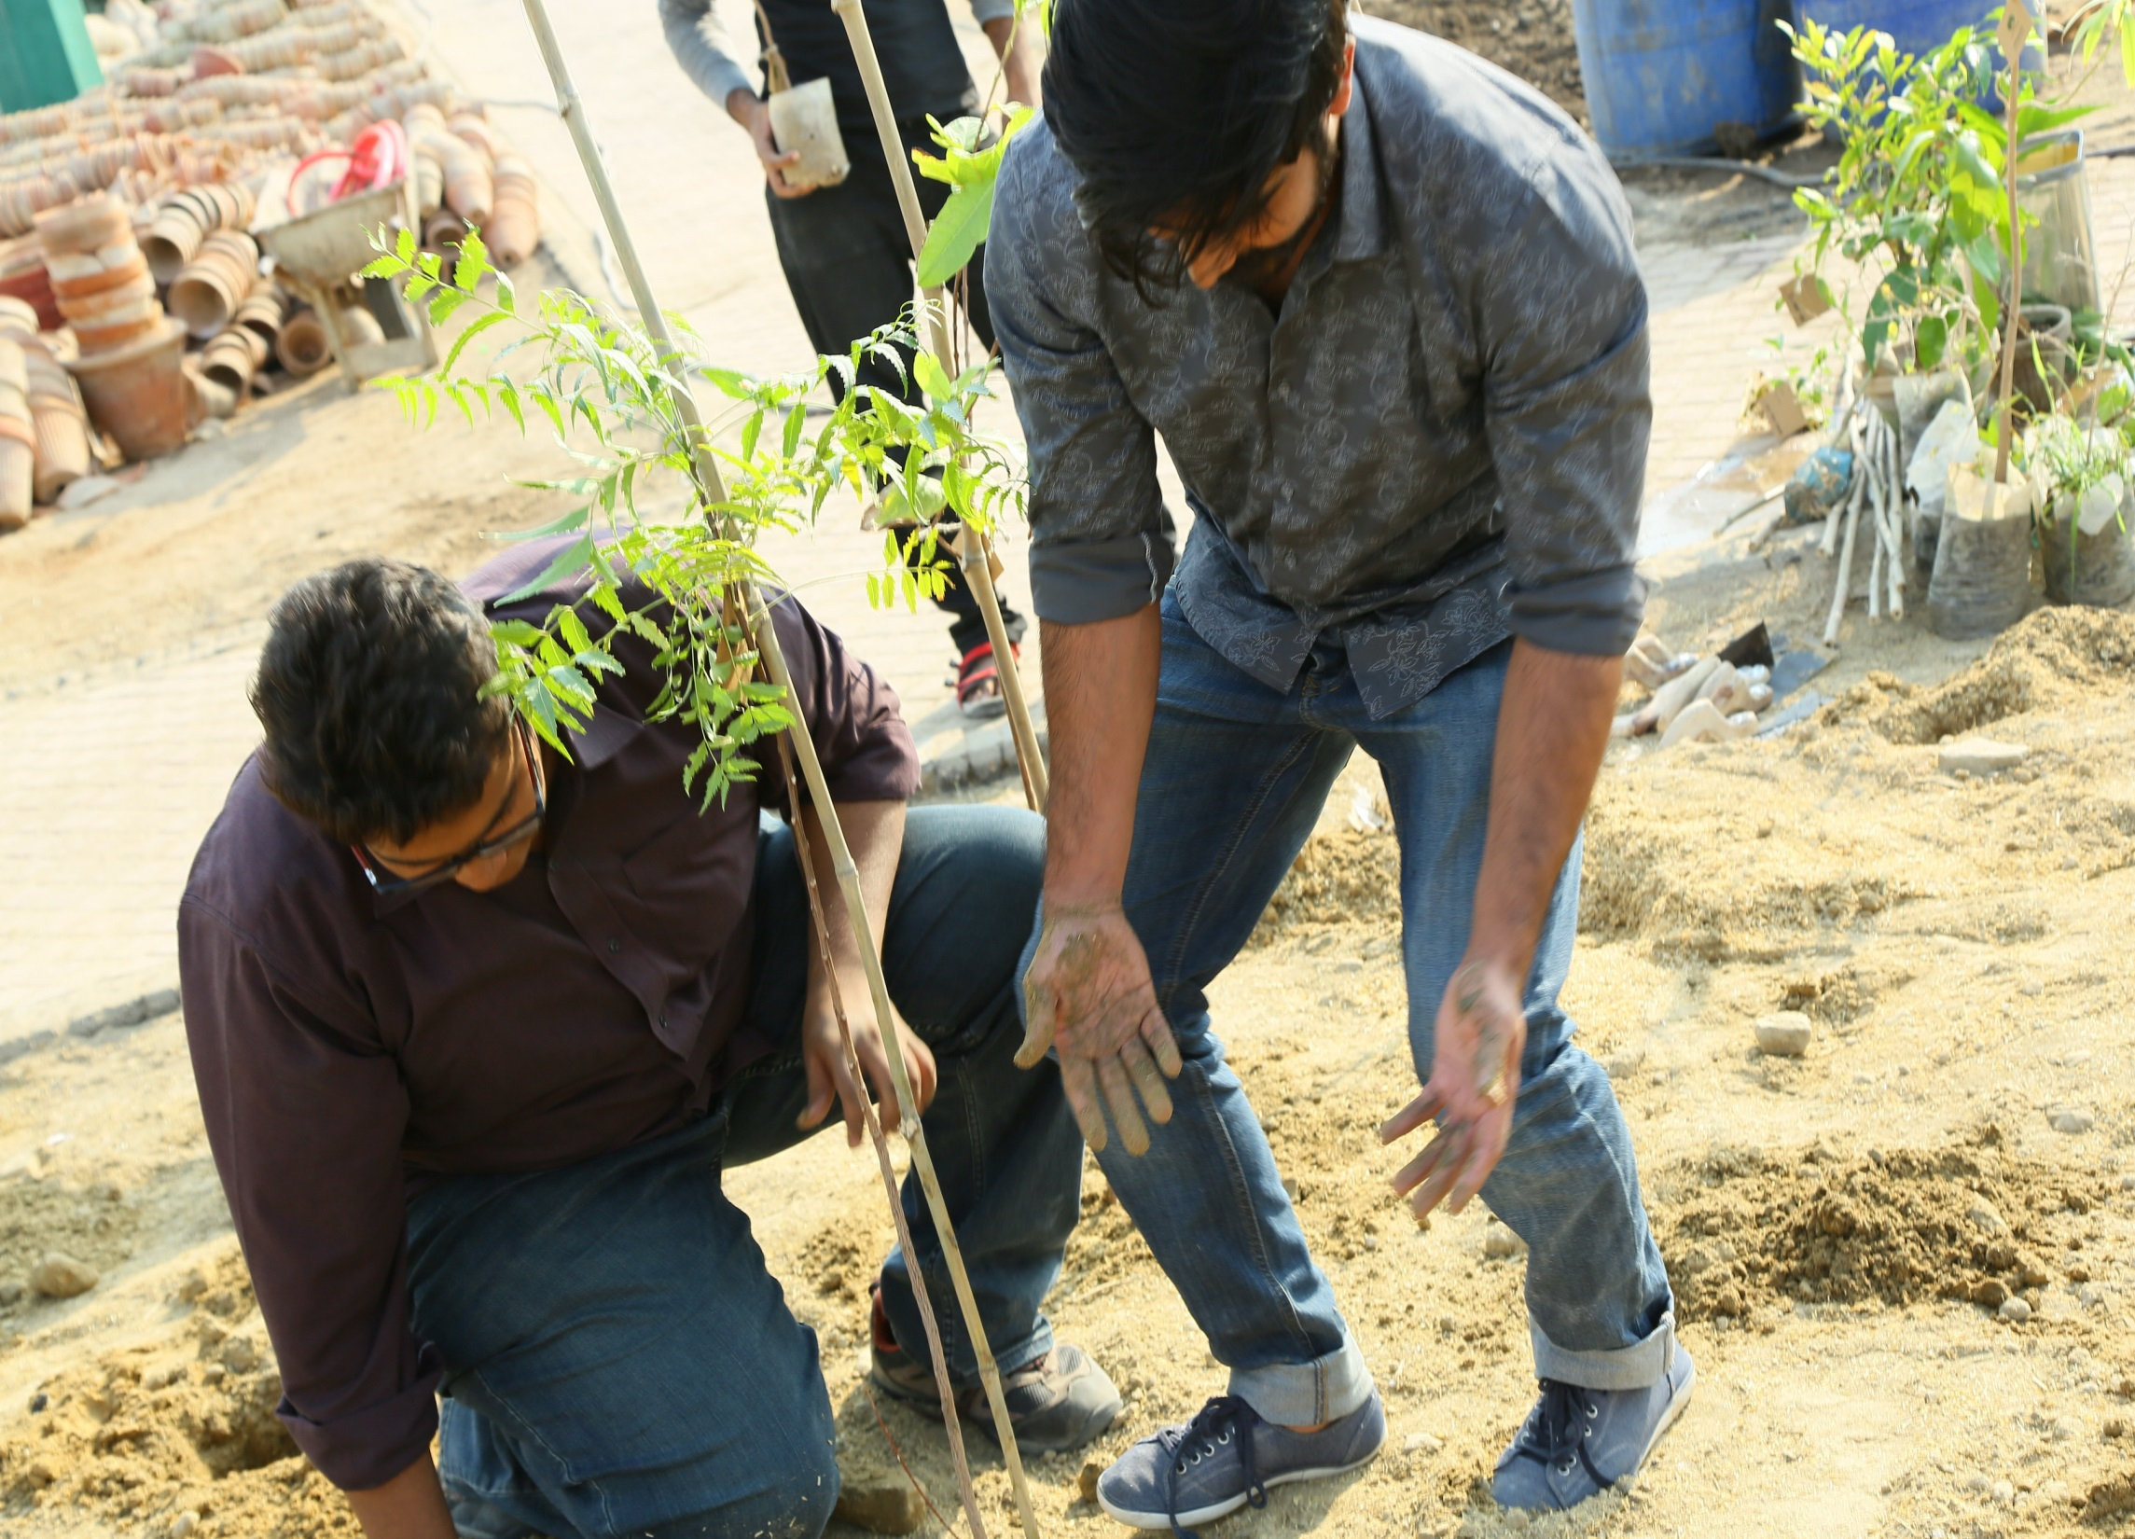

Slide 12
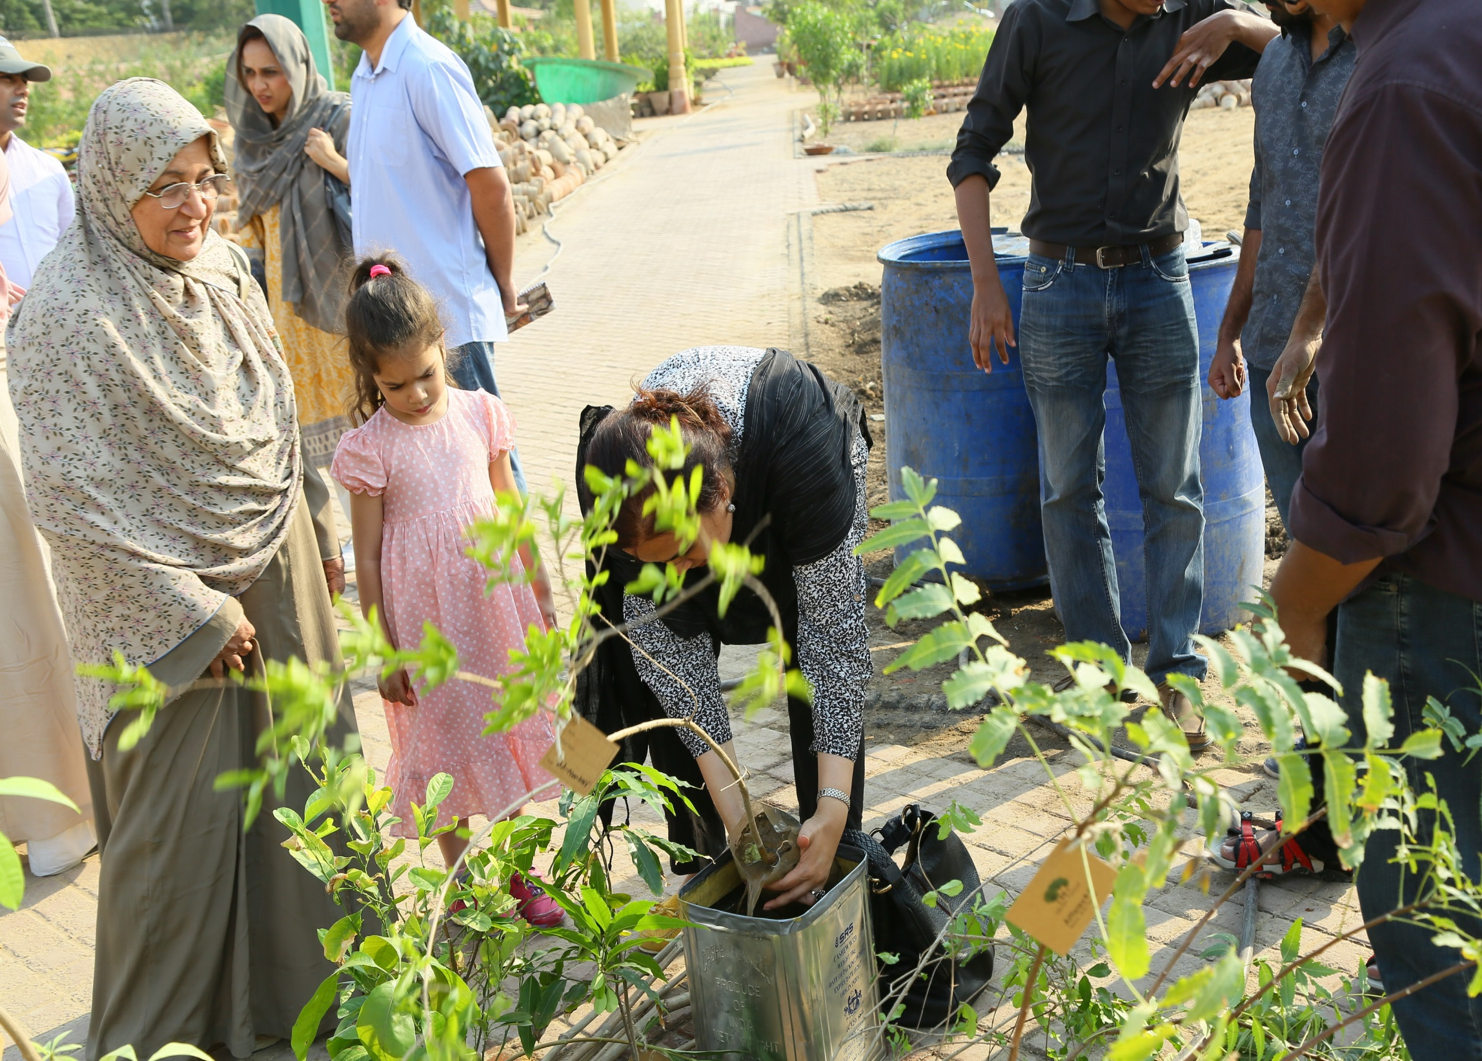

Slide 13
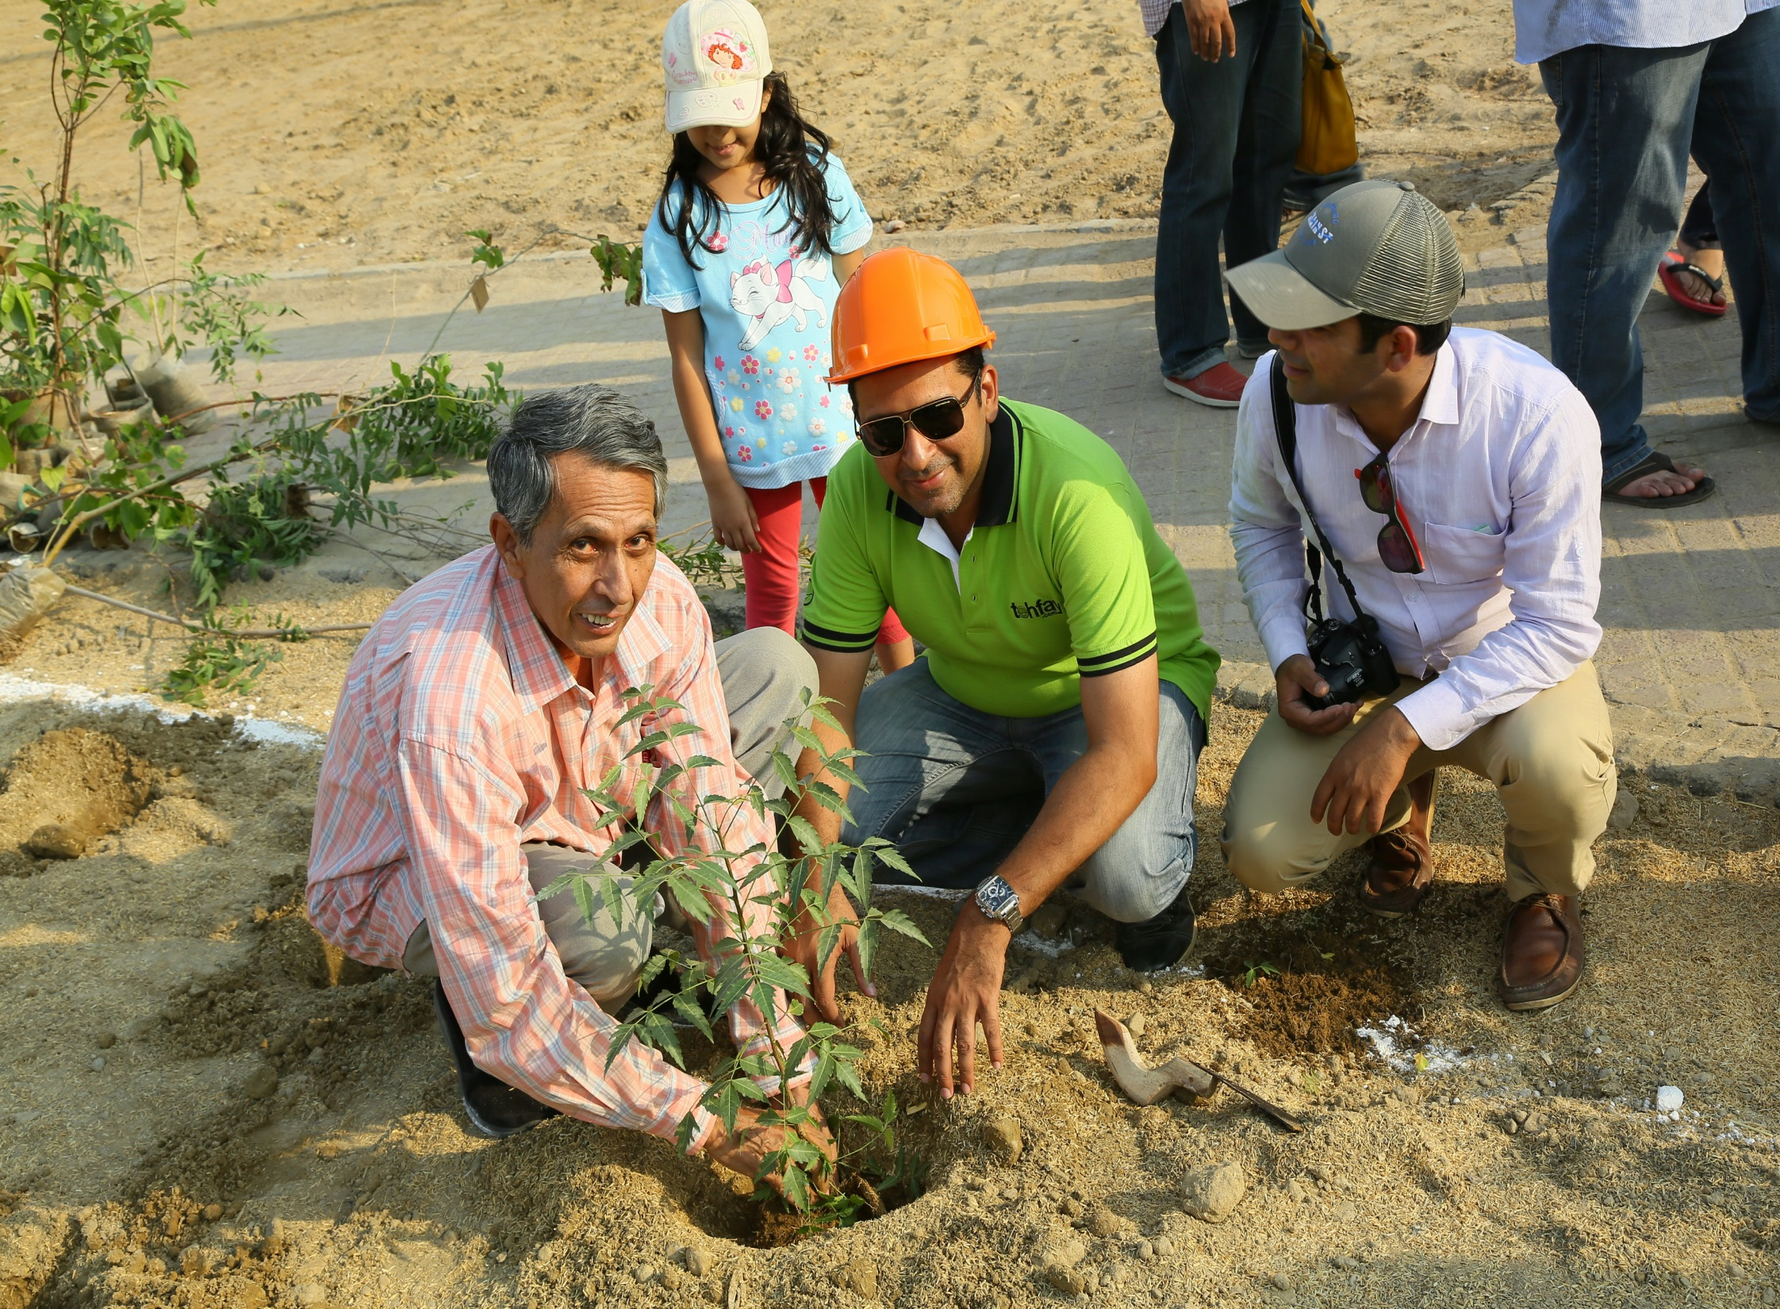

Slide 14
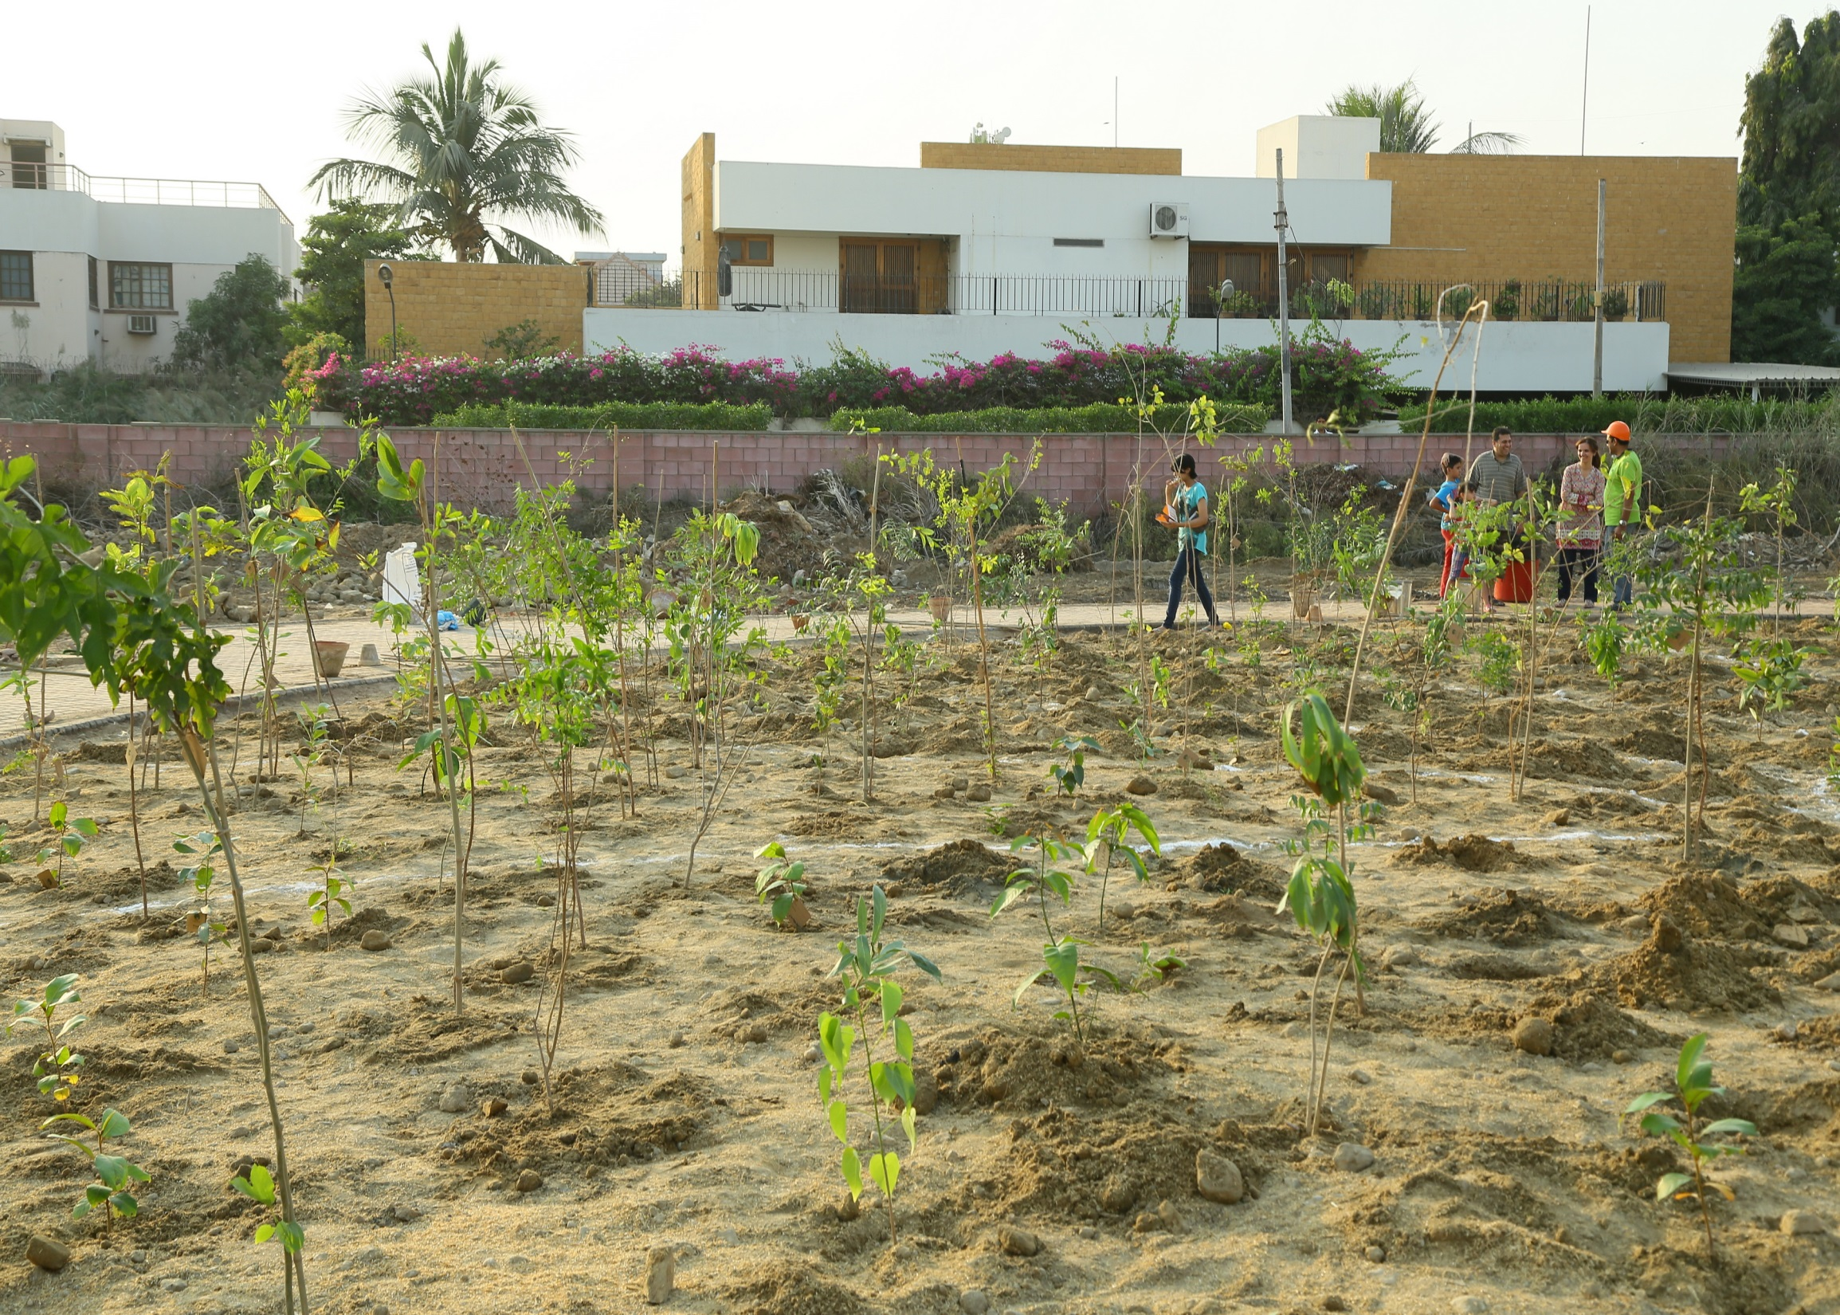

Slide 15
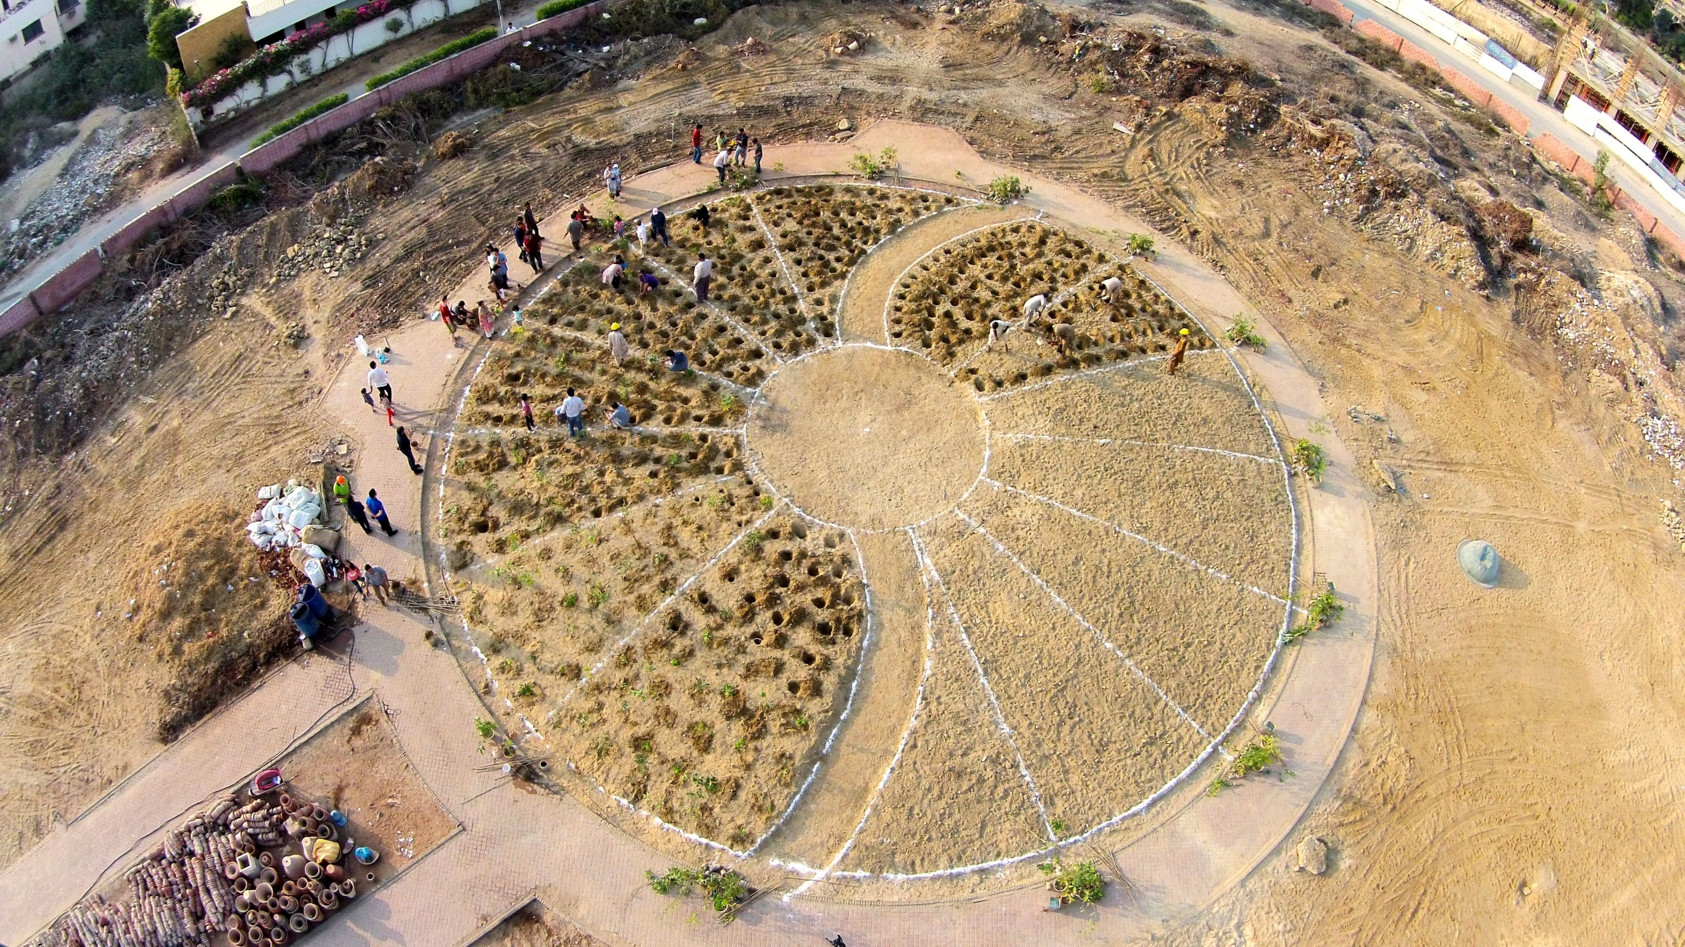

Slide 16
